Slide 1
ASP vNext
Playing With The Alpha Bits
Jeff Ammons

Slide 2
Who Am I?
Jeff Ammons
President GGMUG (Gwinnett, Georgia, Microsoft User Group)
Principal Architect, Sage Software

Slide 3
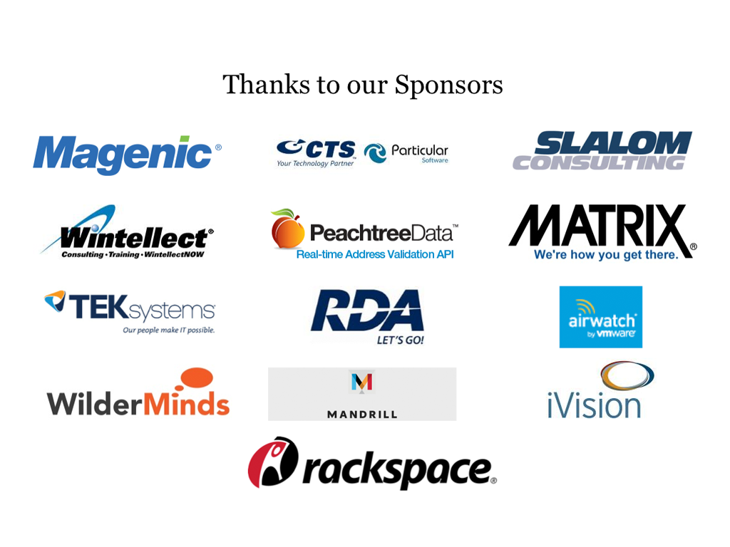

Slide 4
Disclaimers
These are truly alpha bits, not beta
  There be broken bits, captain
  Error messages often include “TODO”
I am not an expert
  I’m just curious and enjoy seeing the new stuff
  So far I like what I see!
I am just the messenger
  I am describing, not proscribing!

Slide 5
Don’t Panic
Most of the new stuff is optional
The bulk of the changes are all about giving you options
Well, panic a little.
  There will be breaking changes

Slide 6
Why The Changes?
Node.js
Ruby On Rails
Non-Microsoft web development is very different
Lots of web developers never even consider Microsoft
Much better architecture
  Not a web framework built on top of a desktop framework

Slide 7
What’s New
Philosophy
Architecture
Choice

Slide 8
Open Source Development
Actual development on GitHub!
  https://github.com/aspnet/Home
  Not just a dump of source at the end
  This is why we can play with the alpha bits today
  Clone your own copy
.Net Foundation
  http://www.dotnetfoundation.org/
Multiple Projects
  MVC
  Entity Framework
  SignalR
  Numerous Others

Slide 9
Cross Platform
Windows Optional
IIS Optional
  Can “self-host” like Node.js
    No need for a web server
    Obviously for limited use cases
.Net Optional
  Can run with Mono on Linux or Mac
    Seriously, I’m not making this up
    The official ASP vNext tests include the Mono version

Slide 10
MVC Merged
MVC 6 is the merging of:
  MVC
  Web API
  Web Pages
Hmm. Notice anything missing?
  Web Forms not included
    It’s development is no longer connected to the rest of ASP
    Built on different libraries/dependencies (System.Web)
    Not discontinued, IS getting some love in the next release, but…
    Future is murky (ier)

Slide 11
ASP preNext (aka current and older)
Web Forms
MVC
Web Pages
WebAPI
ASP (System.Web)
WCF
.Net

Slide 12
ASP vNext
Web Forms
MVC 6
MVC
Web Pages
WebAPI
ASP (System.Web)
OWIN
.Net
.Net/Mono/Cloud Runtime
OWIN: Open Web Interface for .Net

Slide 13
Deploy .Net Version With Your App
Side by Side deployment
  “bin deploy” the framework
Upgrade the .Net version for an app without upgrading whole server
Different apps can run different .Net versions
Also different .Net implementations
  Cloud Optimized version (11 MB instead of 200 MB)
  Mono

Slide 14
Cloud Optimized Version
Leaner, Meaner
11 MB vs 200 MB
Removed many, many dependencies
Add back only what you need via Nuget
Smaller == faster start up

Slide 15
Supremely Modular
Just about everything is pluggable
Nuget is now critical
Legoland
  Lots of little blocks can make almost anything
Faster releases
  Each block can be upgraded independently
  No more 3 year release cycles!
Choose Your Own Blocks

Slide 16
All The New Coolness
Roslyn
  Compiles on the fly optionally directly into memory
  No files needed. Why create files to disk just so you can load them into memory?
  Optionally skip the compile step. Change file, hit F5 in browser and everything recompiles
System.Web? Pfft.
  No dependency on System.Web
  Removes a TON of links to older, desktop code

Slide 17
Changes We’ll Demo
New Project System
New Configuration System
Command-line Tools

Slide 18
Project System
Not MS Build
Child of older Project file and Nuget Package file
  Json
{
"webroot" : "wwwroot",
"exclude": "wwwroot/**/*.*",
"dependencies": {
"EntityFramework.SqlServer": "7.0.0-alpha4",
"Microsoft.AspNet.Mvc": "6.0.0-alpha4",
"Microsoft.AspNet.Identity.SqlServer": "3.0.0-alpha4",
"Microsoft.AspNet.Identity.Authentication": "3.0.0-alpha4",
"Microsoft.AspNet.Security.Cookies": "1.0.0-alpha4",
"Microsoft.AspNet.Server.IIS": "1.0.0-alpha4",
"Microsoft.AspNet.Server.WebListener": "1.0.0-alpha4",
"Microsoft.AspNet.StaticFiles": "1.0.0-alpha4",
"Microsoft.Framework.ConfigurationModel.Json": "1.0.0-alpha4",
"Microsoft.VisualStudio.Web.BrowserLink.Loader": "14.0.0-alpha4"
},
"commands": {
/* Change the port number when you are self hosting this application */
"web": "Microsoft.AspNet.Hosting --server Microsoft.AspNet.Server.WebListener --server.urls http://localhost:5000"
},
"frameworks": {
"aspnet50" : { },
"aspnetcore50" : { }
}
}

Slide 19
Project System
Dependencies
  References
    Register Nuget packages instead of DLLs
Commands
  Set up command line options/targets
    Self hosting port number, etc.
  Publish will yield CMD batch files for commands
Configurations
  Versions to build
  .Net versions targeted

Slide 20
Project System
What do you not see?
  Lists of files
  All files in directories or sub-directories are considered in the project
    Unless you say otherwise
“code” : [“class.cs1, *.cs”],
“exclude”: [“*.exe,*.dll,bin/*”]

Slide 21
Configuration System
Flexible
  JSON (default)
  XML (if you loved web.config)
  INI (if you feel old school)
  Environment Variables (if your head is in the cloud)
  Others can be implemented
Abstracts the reads
  var bar = configuration.Get(“foo:bar”);
    Could be nested in JSON, XML or Env Var formats

Slide 22
Command-line Tools
kvm – K Version Manager
kpm – K Package manager
k – K Runtime
Names will change
K is the Kool Kode name…
  KLR?
  Kloud?
  Krappy Kode Name?
  Turns out it’s because of Katana

Slide 23
Visual Studio Is Still The King
Command-line Tools Aren’t Required
  Nifty
  Allow using any text editor
    How about Monaco?
      Microsoft’s JavaScript based cloud editor
  Allow using Linux or Mac
Visual Studio still easiest path
  Not sure how to debug on Mac or Linux

Slide 24
Linux and Mac!!
With Mono it really does work
  ASP vNext unit tests include Mono
    If it doesn’t work on Mono, it doesn’t pass*
  It is currently painful to get it to work on Linux
    Had to build Mono from source to get right version
    Had to make several lib projects that were missing
    Kestrel doesn’t work, but Nowin does
      Nowin is an implementation of OWIN
    Upgraded kvm and restored packages: kaput…
      Turns out it was the change from IAppBuilder to IApplicationBuilder
  I don’t have a Mac
    Sorry
* Yes, I am taking that with some salt

Slide 25
Visual Studio + Command-line
Visual Studio (so far) doesn’t add command-line tools
Instructions for adding CL found at http://blogs.msdn.com/b/webdev/archive/2014/08/21/command-line-scaffolding-for-asp-net-vnext.aspx
From an admin command prompt execute the following command.
powershell -NoProfile -ExecutionPolicy unrestricted -Command "iex ((new-object net.webclient).DownloadString('https://raw.githubusercontent.com/aspnet/Home/master/kvminstall.ps1'))“
You should exit the command prompt after executing this command. Some environment variables are set that need to be applied before continuing.
Now we need to download the latest kvm package. To do this open a new command prompt (Note: for the next few steps do not use a PowerShell prompt) execute the following two commands.
set KRE_NUGET_API_URL=https://www.myget.org/F/aspnetvnext/api/v2
kvm upgrade

Slide 26
VS + Command-line Gotcha
Remember Visual Studio uses the *default* K runtime
If you update to get a newer version and Visual Studio won’t build,
try setting the default back to the older runtime
Tell-tale error will look like:
Kvm alias default 1.0.0-alpha3
Error 8 The command ""C:\Users\Administrator\.kre\packages\kre-svr50-x86.1.0.0-alpha4-10353\bin\klr.exe"
"C:\Users\Administrator\.kre\packages\kre-svr50-x86.1.0.0-alpha4-10353\bin\lib\
Microsoft.Framework.PackageManager\Microsoft.Framework.PackageManager.dll" build --check
"c:\demos\projects\TestVNextApp03\TestVNextApp03" --configuration Debug" exited with code 1.
C:\Program Files (x86)\MSBuild\Microsoft\VisualStudio\v14.0\AspNet\Microsoft.Web.AspNet.targets 136 5 TestVNextApp03

Slide 27
Resources
http://www.asp.net/vnext
https://github.com/aspnet/home
http://support.microsoft.com/kb/2967191
http://davidfowl.com/asp-net-vnext-architecture/
http://blogs.msdn.com/b/webdev/archive/2014/06/17/dependency-injection-in-asp-net-vnext.aspx
http://blogs.msdn.com/b/webdev/archive/2014/08/12/develop-asp-net-vnext-applications-on-a-mac.aspx
https://www.youtube.com/watch?v=Ie_0k1_9LJ0&list=PL0M0zPgJ3HSftTAAHttA3JQU4vOjXFquF
  ASP Team Weekly Stand Up On Google Hangouts
http://www.asp.net/aspnet/overview/owin-and-katana

Slide 28
My Contact Info
Twitter: jeffa00
Blog: AmmonsOnline.com

Slide 29
Dependency Injection
Simple version baked in
Plug in your favorite DI framework

Slide 30
What Is Dependency Injection?
Specify the kind of service you need (like a repository class)
  Usually by interface
    eg. IFooRepository
Inject an object that implements IFooRepository at runtime
  Often via the constructor
Now you could have different kind of IFooRepositories for different uses
  FooTestRepository
  FooEntityFrameworkRepository
  FooAdoRepository

